Slide 1


SMART INDIA HACKATHON 2025
Autonomous Hybrid-Control Drone Swarm for Threat Detection and Defense
Problem Statement ID – 25164
Problem Statement Title - Designing an Efficient Algorithm for Coordinated Swarm Engagement among Autonomous Drones aiming to neutralize an adversarial drone swarm.
Theme- Robotics and Drones
PS Category- Software
Team ID - 86511
Team Name - CODEX.PY

Slide 2
Autonomous Hybrid-Control Drone Swarm for Threat Detection and Defense [HDTD]
CODEX.PY
PROPOSED SOLUTION:
Autonomous Hybrid-Control Drone Swarm algorithm for Threat Detection and Defense compatible with all drone types and makes
Hybrid Control Centralized mission planning with autonomous decision-making for each drone.
Swarm Coordination Selecting a leader, controlling formations, and task allocation based on Coordination.
Autonomous Threat Handling Avoiding obstacles, tracking targets, and simulating neutralization.
Scalable Attack Mechanisms by Jamming models coordinated movements, and simulations using Faraday methods.
Resilient Networking using Wi-Fi TCP/UDP mesh for reliable operation and protection against jamming situations.

Slide 3
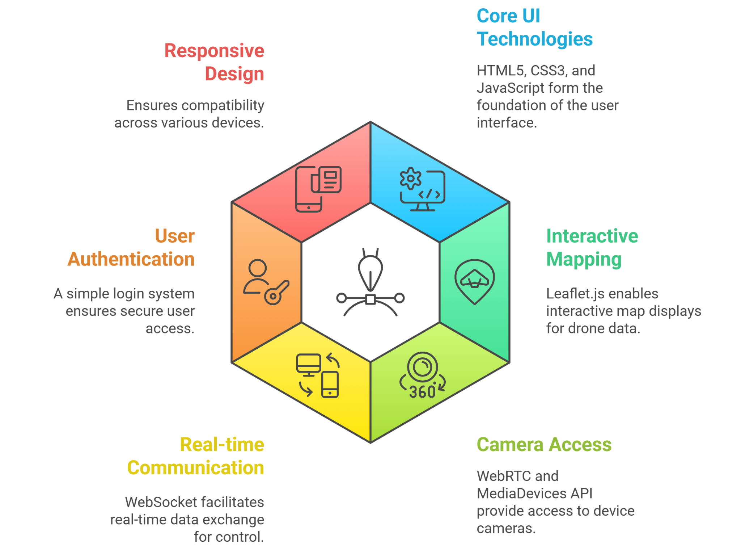
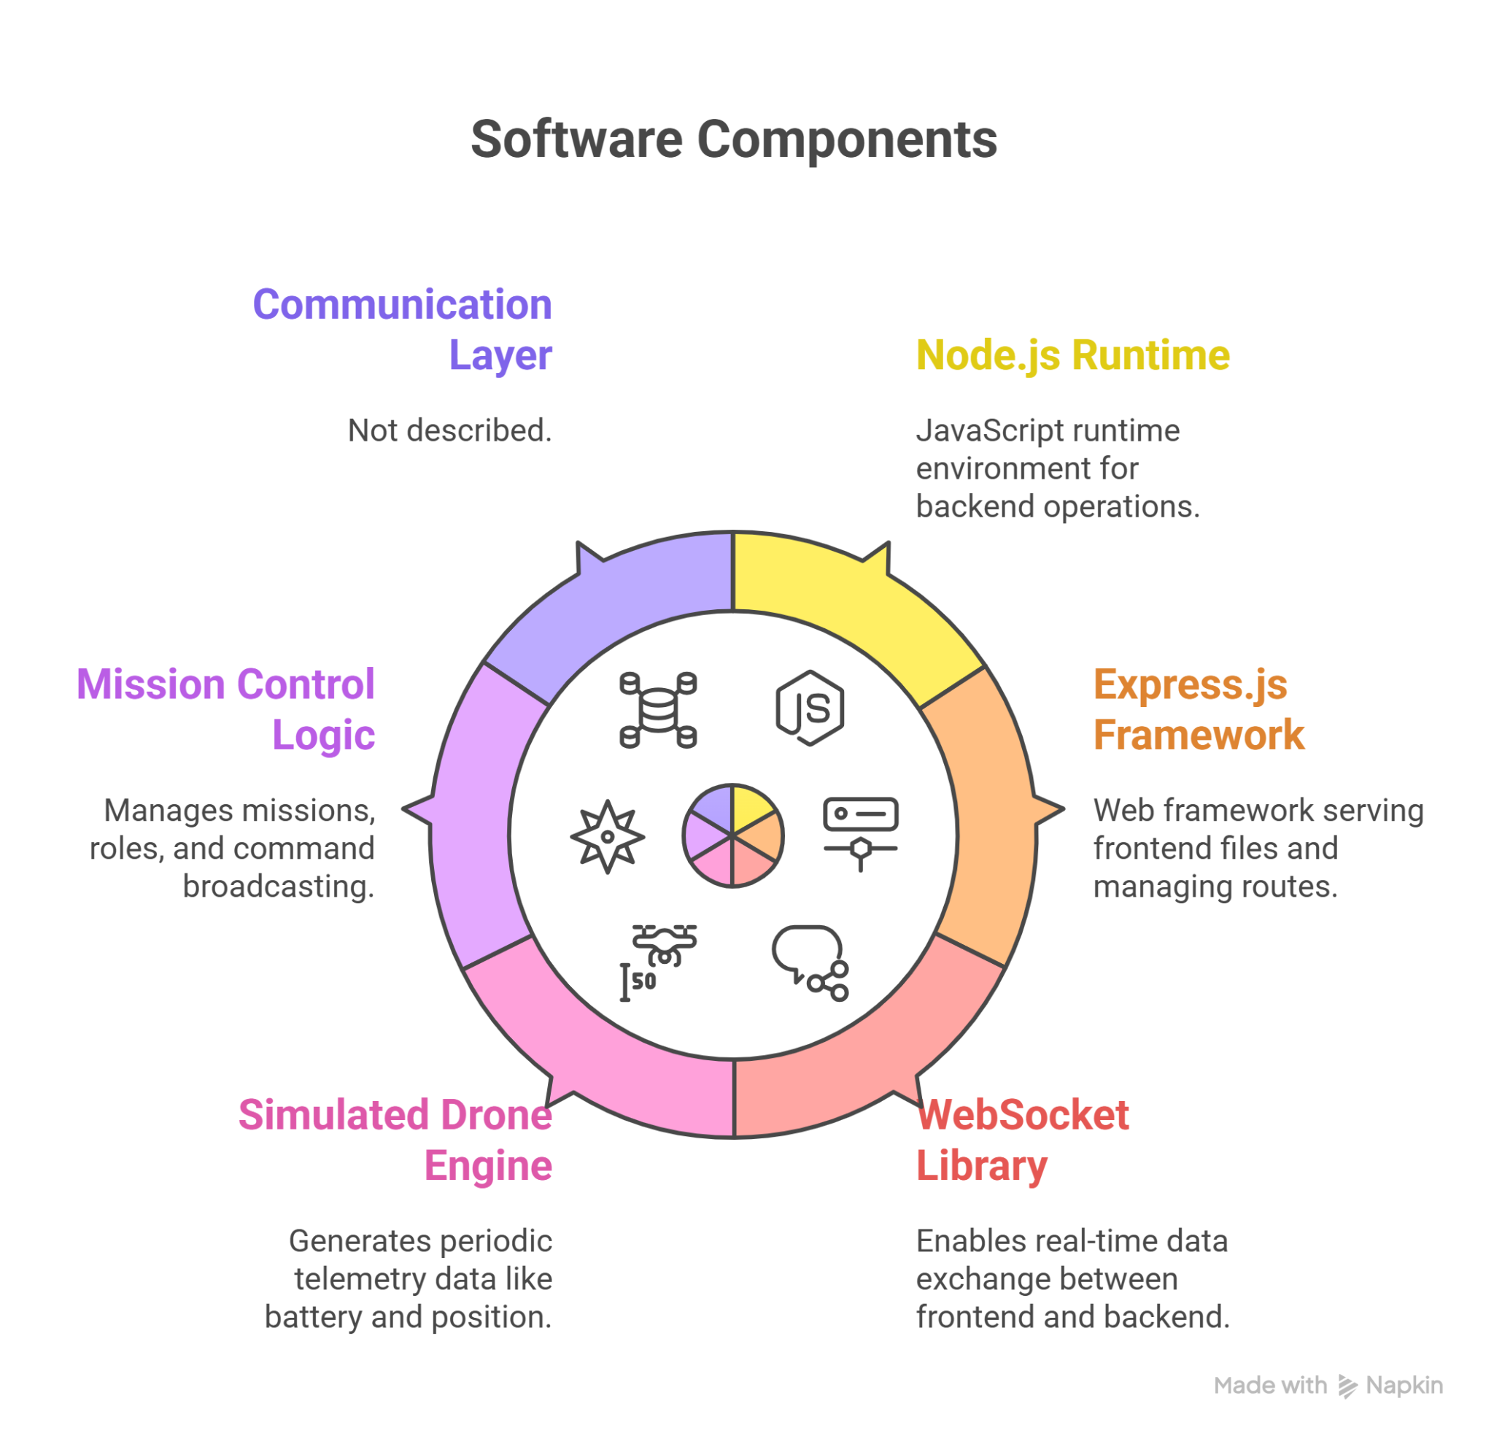
TECHNICAL APPROACH
CODEX.PY
FRONT-END STACK
BACK-END STACK

Slide 4
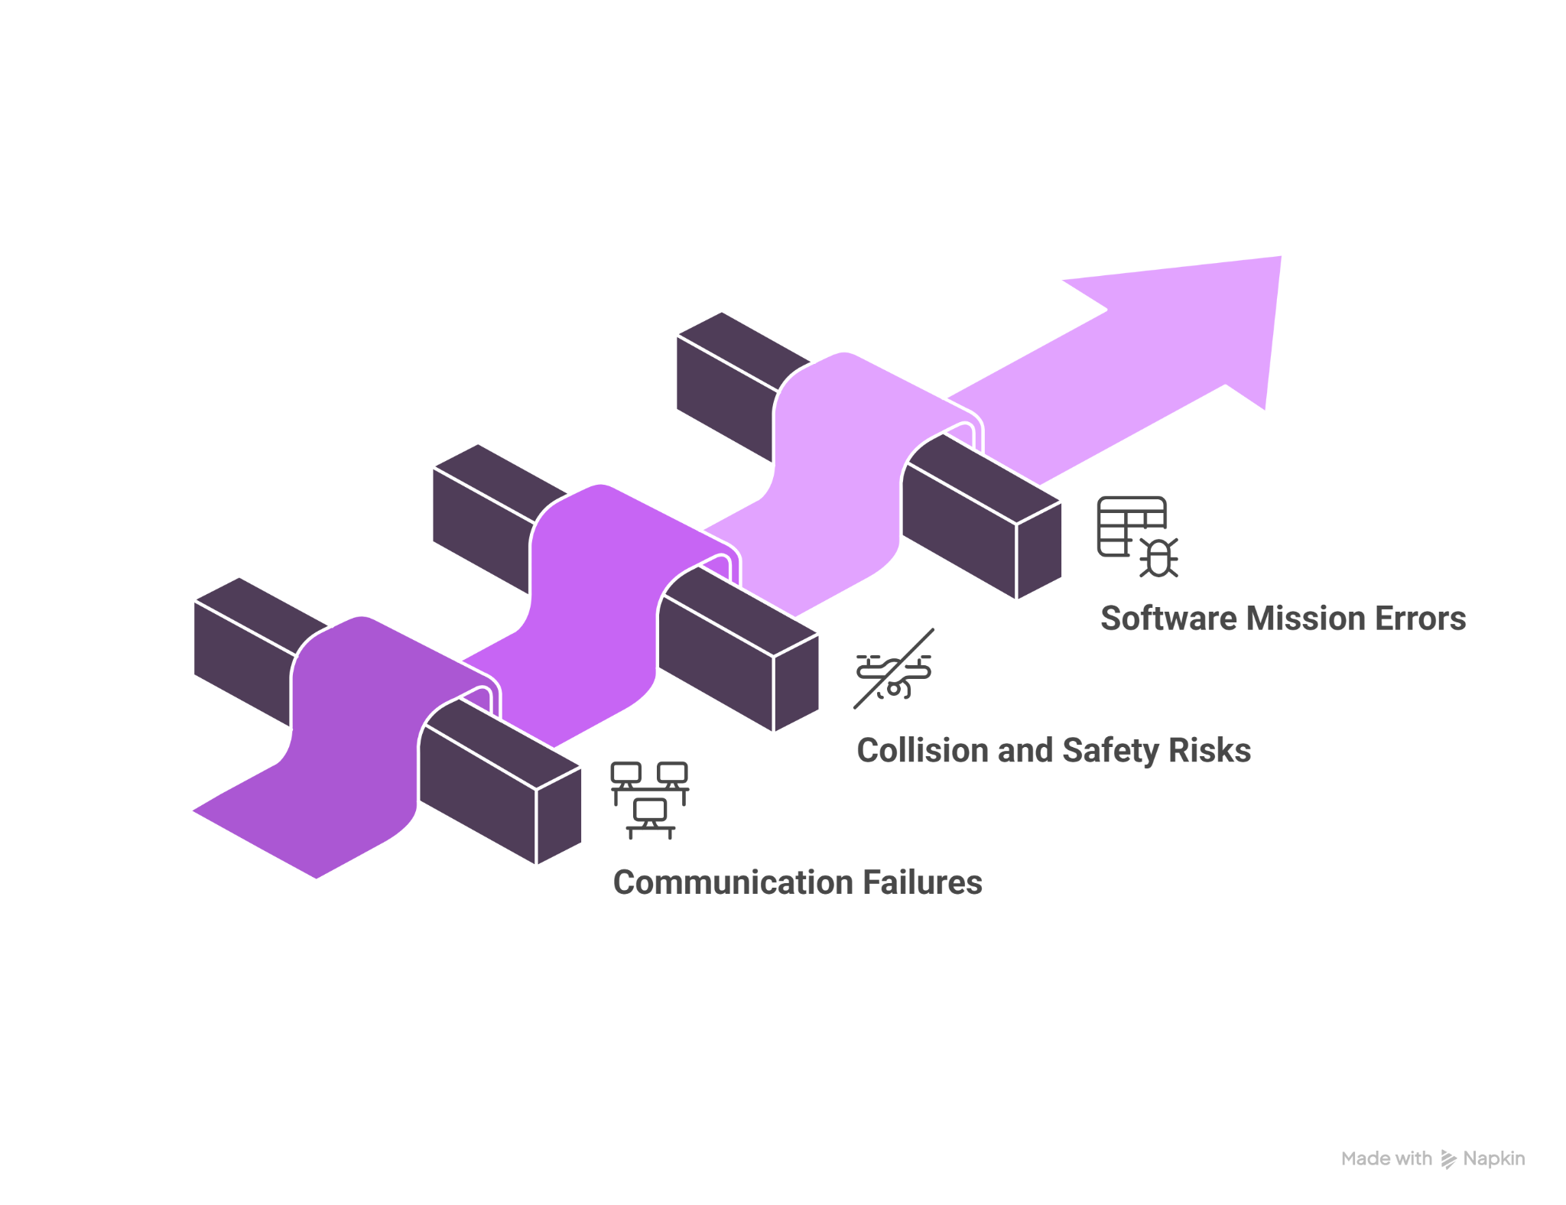
FEASIBILITY AND VIABILITY
CODEX.PY
Analysis of the feasibility of the idea:
Technically feasible: One-stop swarm control software with role assignment, mission planning, telemetry, and video streaming can be built using PX4/ArduPilot, Raspberry Pi/Jetson, MAVSDK, React/MapLibre, MQTT/WebSocket, and WebRTC.
Legally safe: Fully compliant if it avoids jamming or weapons, with geofencing, fail-safes, secure comms, and regulatory approvals for drone operations.
Operationally scalable: Phase-1 software MVP → SITL/HIL testing → small swarm demo (3–5 drones) → gradual scaling; Phase-2 minidrone demo showcases software capabilities effectively.
Technical viabilities in implementation
Strategies to Overcome Challenges:
Robust networking & fail-safes – LAN-first design, redundant Wi-Fi/mesh, heartbeat monitoring, and automatic hover/RTB on loss.
Collision avoidance & geofencing – Software geofencing, safe altitude separation, and reactive collision avoidance (ORCA/RVO2).
Incremental testing & validation – SITL → single-drone HIL → small swarm demo → scale; mission simulation and automated test scripts.

Slide 5
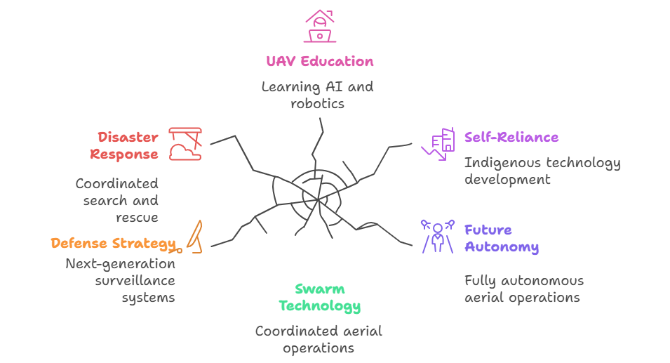
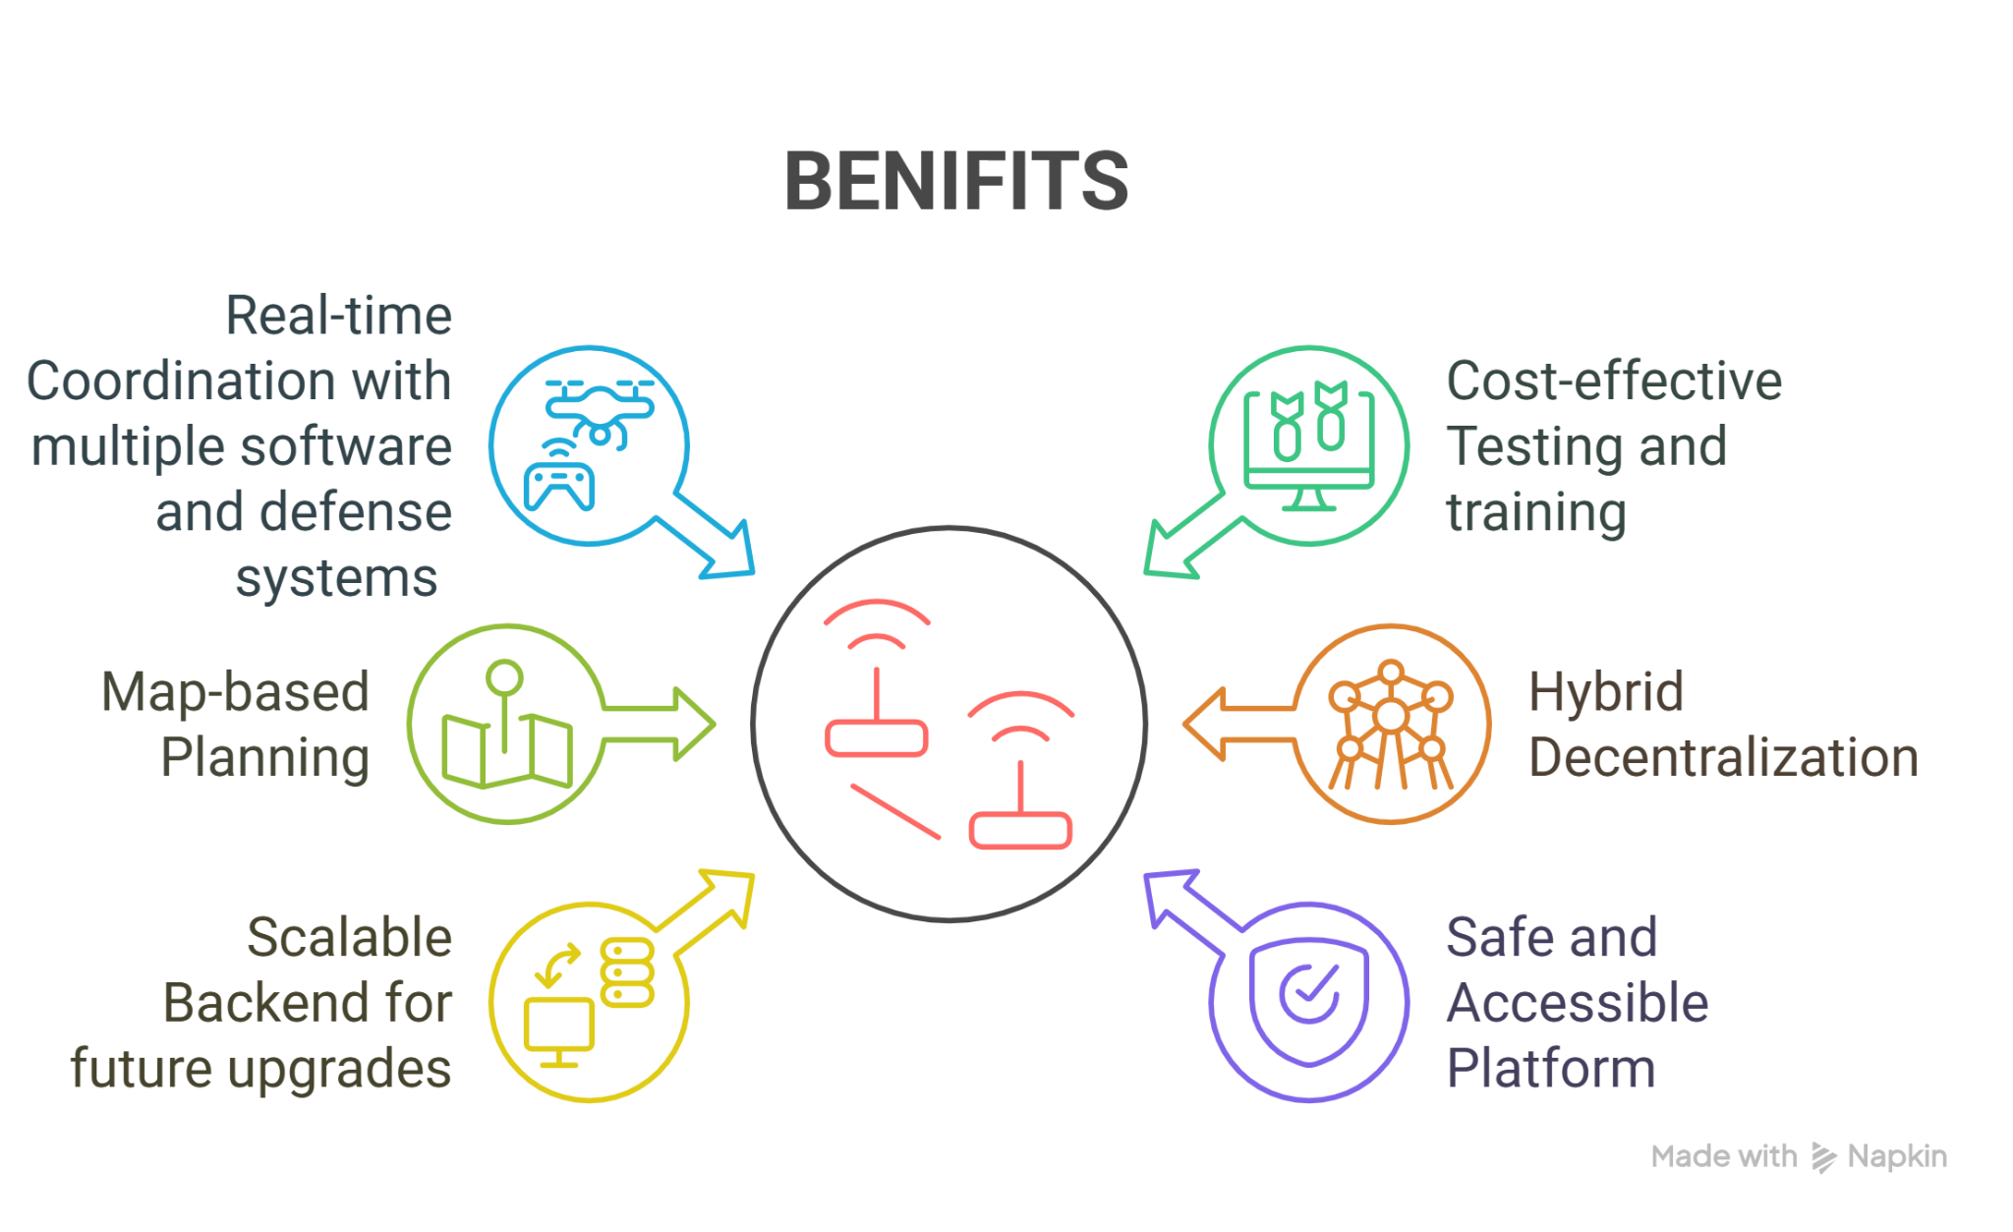
IMPACT AND BENEFITS
CODEX.PY
IMPACT OVER CURRENT OPERATIONS
.
BENEFITS

Slide 6
RESEARCH AND REFERENCES
CODEX.PY
Details / Links of the reference and research work
USA fleet forces command”s project on swarm drones https://www.usff.navy.mil/Press-Room/News-Stories/Article/4225896/navy-successfully-demonstrates-swarm-mission-planning-tech
Mavlink protocols for information security in drone swarm
https://dl.acm.org/doi/pdf/10.1145/3634737.3637672
Drone swarm coordination and characterization with radio frequency signals
https://www.mdpi.com/1424-8220/23/3/1589
JTIR development of the surveillance drone setup
https://www.jetir.org/papers/JETIR2504147.pdf
IoT drones for industrial security and adversaries
https://iopscience.iop.org/article/10.1088/1742-6596/2107/1/012018/pdf
Current drone design in industry standard by ijraset
https://www.ijraset.com/research-paper/design-and-development-of-surveillance-drone
SWARM DRONE management
https://www.sciencedirect.com/science/article/pii/S2452414X18300086?via%3Dihub
Aerial unmanned vehicles -horizon and health
https://pmc.ncbi.nlm.nih.gov/articles/PMC11116996/
Collaborative drones in surveillance in indian conditions
https://www.iadb.in/2024/12/31/swarm-intelligence-collaborative-unmanned-drone-systems-for-maritime-surveillance/
Types of drones in Indian Air Force in modern warfare
https://www.insightsonindia.com/2025/06/10/drone-the-new-face-of-warfare/
MavSdk applications on drone development and building
https://circuitcellar.com/research-design-hub/design-solutions/writing-mavsdk-px4-drone-applications/

